Slide 1
Project Summary
Dec 2020
James Allwein, Bing Gao, & Megan Reichert

Slide 2
Agenda
Project Overview
Project approach
Ballet Industry Overview
Fellowship Program Overview
Key Findings
Qualitative
Quantitative
Final Recommendations

Slide 3
Project Overview
“Men in nontraditional occupations face a different scenario – their gender is construed as a positive difference.”
- Christine Williams, “The Glass Escalator: Hidden Advantages for Men in the ‘Female’ Professions”

Slide 4
Project Overview | Approach
Hypothesis: We know that ballet companies disproportionately commission male choreographers in the United States. This project is specifically focused on looking further up the funnel at the career trajectories of men vs. women coming out of the same prestigious choreographic fellowship programs.
I. Research Design
II. Data Gathering
III. Data Analysis
Gain better understanding of the project background and project objectives
Align on project initial plan and scope
Determine Data Gathering Plan
Prepare and structure raw data for analysis
Collect feedback from DDP on data
Prepare descriptive statistics and interpret data output
Extract insights and form recommendations

Slide 5
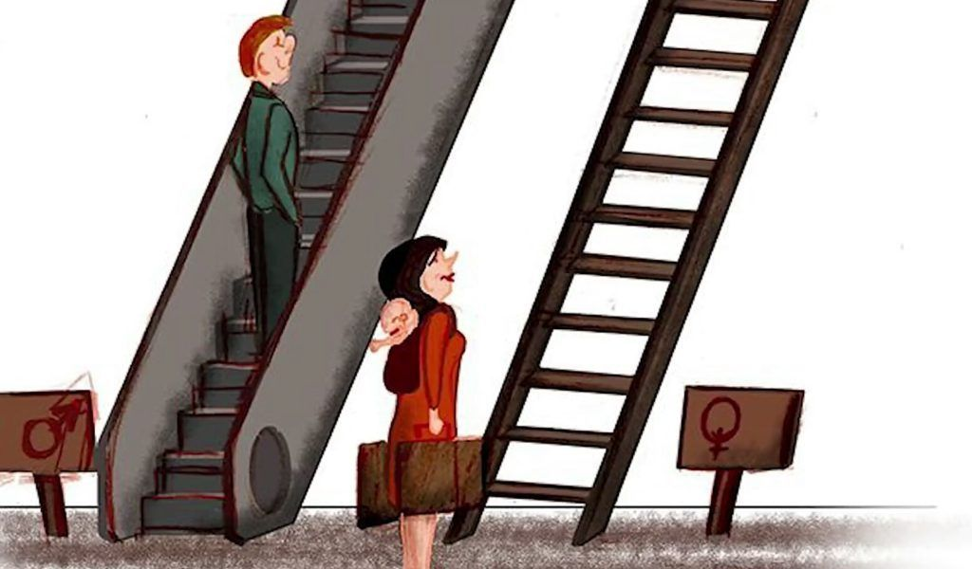
Project Overview | Ballet Industry
Girls are estimated to outnumber boys 20-1 in ballet classes; this continues into professional companies
Men represent 76% of ballet company resident choreographers
At the top 50 ballet companies in the world men choreographed 79% of the 467 works in the 2019-20 season
The highest-paid male artistic director earned $900K in 2017, while the highest-paid female artistic director earned $325K
Company executive/board leadership is roughly 56% men, while 70% of ballet donors and audience members are women
Christine Williams coined the term glass escalator to illustrate the phenomenon of men getting placed on a fast track to top leadership positions when they enter female-dominated fields

Slide 6
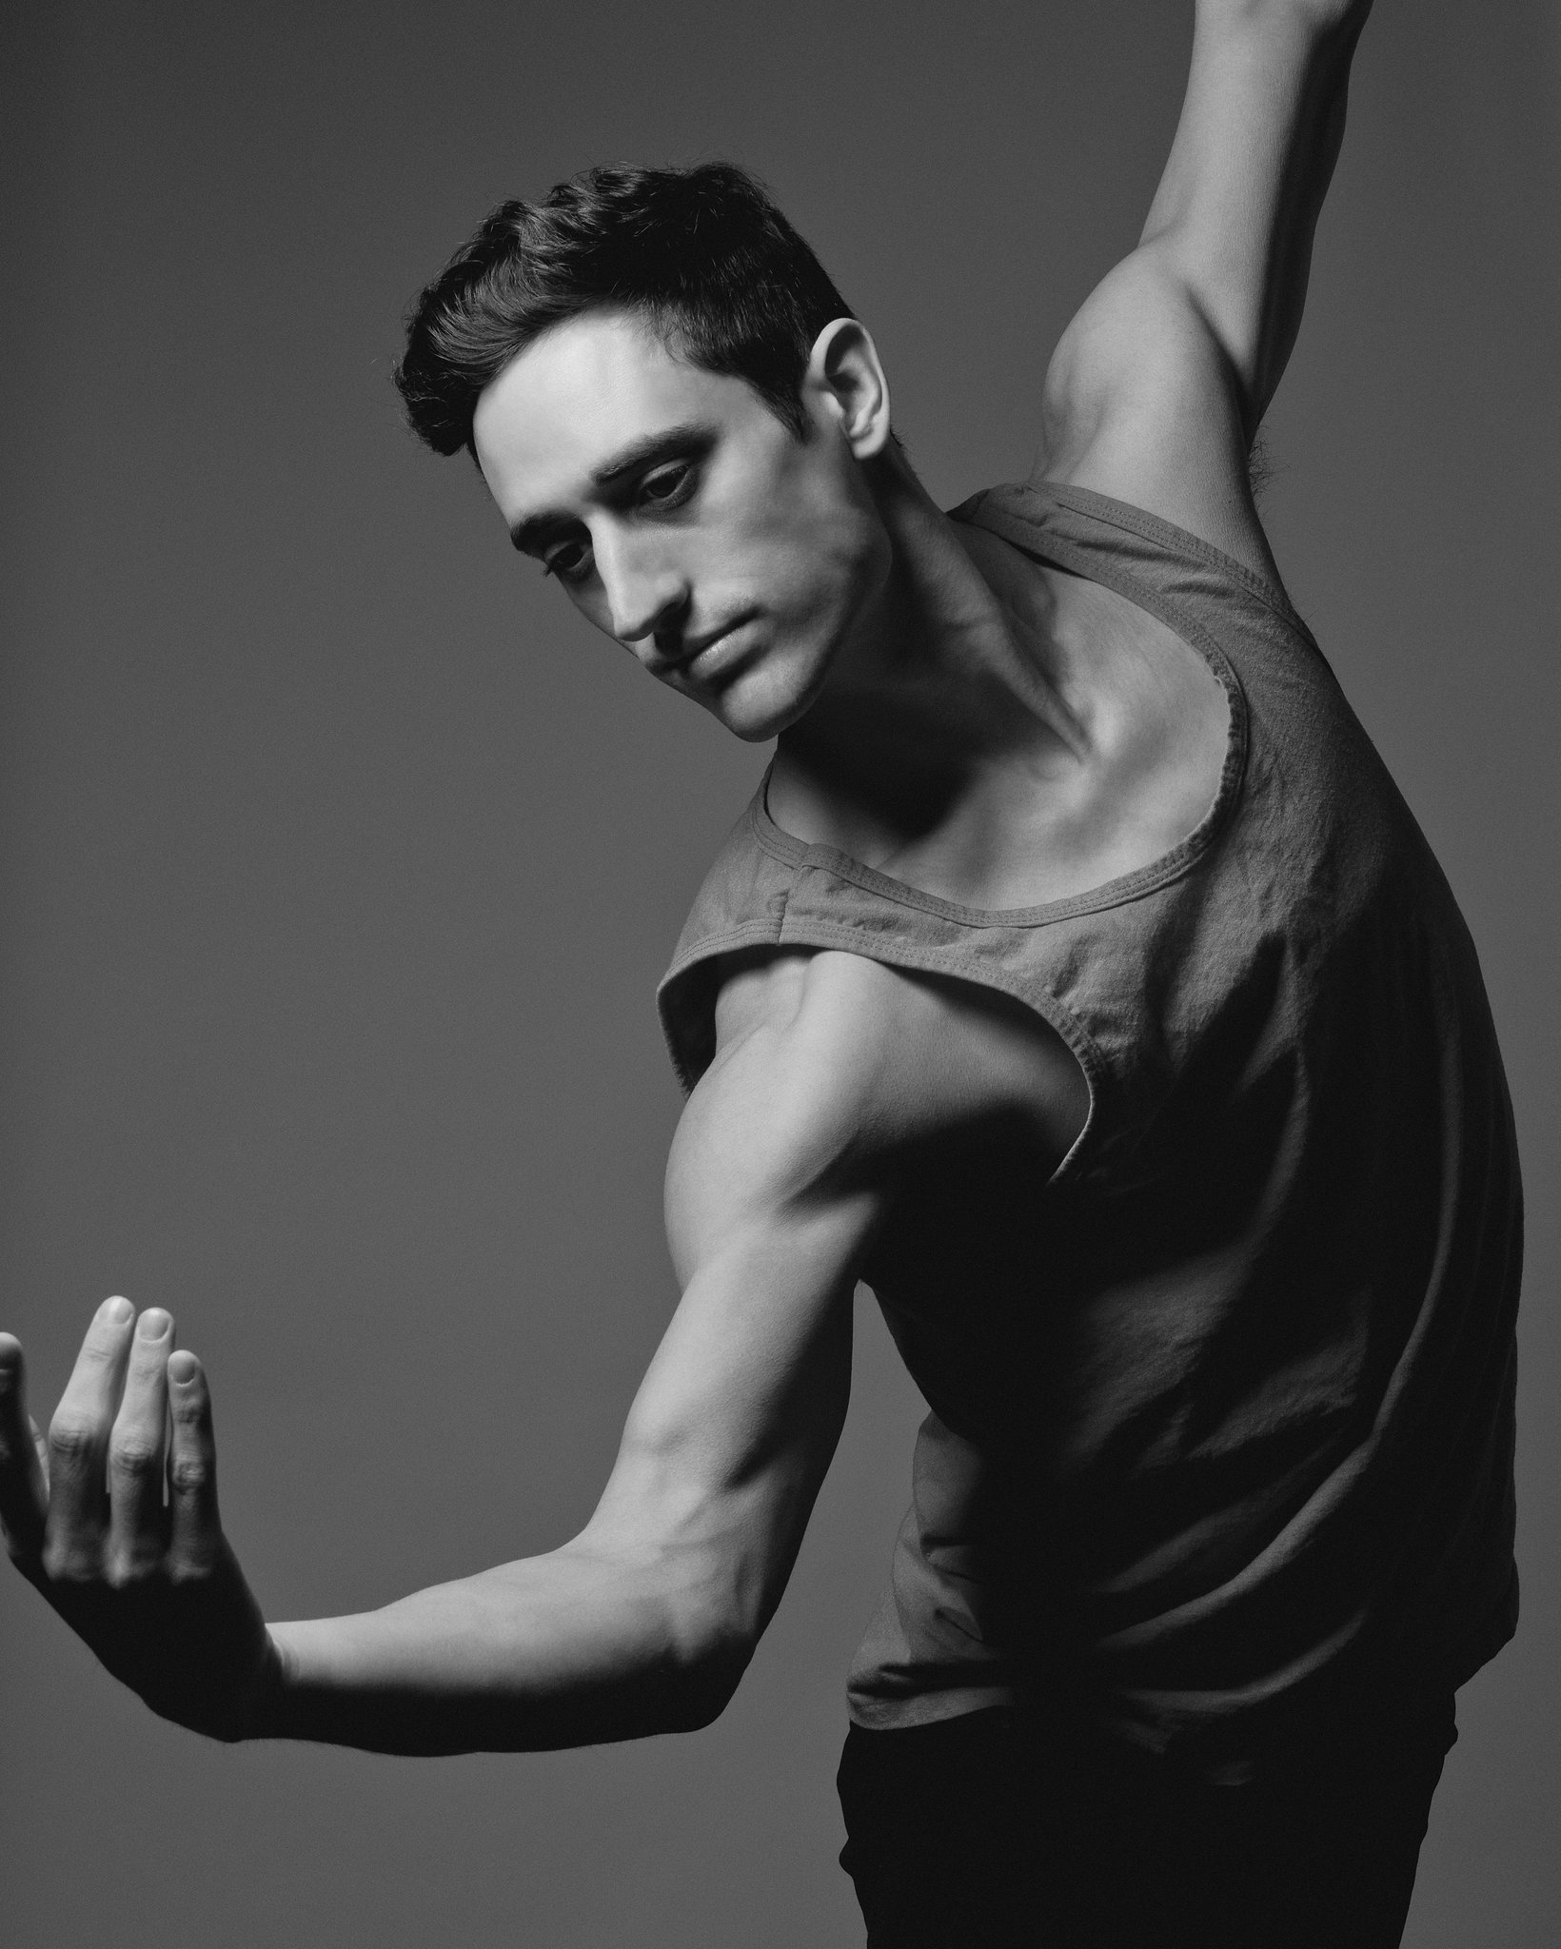
Project Overview | Choreography Career
Sample Career of a renowned choreographer – Justin Peck
Receiving prestigious fellowships in 2011 and 2012 boosted his choreography career
His position as soloist at NYC Ballet was the foundation to his success

Slide 7
Project Overview | Fellowship Programs
Purpose of Choreographer Fellowship: Choreographers have long had to scour the internet and dance magazines, searching for various opportunities to workshop and choreograph on dancers. These awards can be very competitive, and artists must often apply several times to multiple programs before receiving commissions.
Program | # of Recipient per cycle | Details | Frequency
Alvin Ailey Dance Foundation New Directions Choreography Lab Fellow | 4 | $9,500 resident fellowships to four emerging or midcareer artists each year | Once a year
BalletX - Choreographic Mentorship | 1 | Mentorship by renowned choreographer, $5,000 choreographic fee to create a 20-25 minute ensemble ballet on the company’s 10 dancers, round-trip transportation to Philadelphia, per diem, accommodations, budget of $7,000 for costumes, scenic design, and music (original composition or rights), a minimum of 12 performances of the work at a Philadelphia theater | Once a Year
Guggenheim Choreography Fellow | 3 – 10 choreographer | Fellowship Grants, amounts vary | Once a year
Joffrey Ballet - Winning Works | 3 - 5 | $5,000 stipend, 2 Roundtrip flights to Chicago and housing accommodations, per diem, 30+ hours of rehearsal, rehearsal assistant, costume designer, and lighting designer. Mentorship opportunity | Once a Year
Joyce Org Creative Residency | 1 - 2 | $25,000 commission toward creation of work during residency, rehearsal assistant, advisor, 240 hrs of space for research and development | Irregular

Slide 8
Project Overview | Fellowship Programs
Purpose of Choreographer Fellowship: Choreographers have long had to scour the internet and dance magazines, searching for various opportunities to workshop and choreograph on dancers. These awards can be very competitive, and artists must often apply several times to multiple programs before receiving commissions.
Program | # of Recipient per cycle | Details | Frequency
Milwaukee Ballet - Genesis Competition | 3 | 2 year long competition culminating in 3 performances selecting one winner. the program selects finalists who will showcase new works created on the company and vie for the prize of a commission—which will be awarded by a panel of guest artistic directors. | Once a Year
New England Foundation for the Arts - Nat'l Dance Project - Production Grant | N/A | 'Production Awards' are for dance works instead of individuals. support up to 50% of the artist’s fee, including housing, per diem, and travel; receive up to $35,000 in reserved funds to support a U.S. tour | Once a Year
National Choreographers Initiative (NCI) | 4 | Residency to workshop, create new works, and stage them for a showing | Once a Year
NYU Center for Ballet and Arts (CBA) Residency Fellowship | Many, 2-10 each year in ballet discipline | $2,500 per week, use of NYU Center for Ballet and the Arts studio, offices, and conference room, housing, transportation, and visa. | Three times a year (fall, summer, spring)
NYC Centre | 1 - 3 | The Fellowship, which provides three choreographers with a creative home at City Center for one year, reflects City Center’s long history of nurturing dance makers from George Balanchine to Christopher Wheeldon. | Once a Year

Slide 9
Key Findings
“This is not a pipeline issue. It is a failure of imagination by a field whose job is to imagine the way the world could be.”
- Rachel Chavkin, Tony award-winning director of “Hadestown”

Slide 10
Key Findings | Qualitative
Scarcity of men at the more junior levels results in:
Men facing less competition for lead roles
Men having more leeway to pursue the creative aspects of dance over the more technical aspects
Chorographers must engage in a lot of storytelling and showmanship when pitching or selling their works – like many other industries when “she” vs. “he” tells a story it is heard differently
Like the VC/start-up world there are the idolized “geniuses” that get significant attention and billing for the more prestigious choreography-commissions, tied almost exclusively to male personas
One industry specialist claimed that men’s works tended to get more attention and billing because they featured more extreme moves, whereas women’s works featured movements more natural to the female form (an opinion – illustrating trend of attempting to rationalize away inequities)
Note: Qualitative Analysis highlights key learnings from various 1:1 interviews and ballet documentaries

Slide 11
Key Findings | A Narrowing Funnel
At face value the equity scores suggest gender equity at the fellowship level
There is no clear trend of inequity at the fellowship level, yet we notice a shift in the demographic make-up to include more men than the suspected applicant pool – indicative of a narrowing funnel that could in part explain the later more observable gender disparities at the choreography-commissioning level
However, critical data is missing to make a clear assertion; most notably:
The gender divide of the applicant pool
The different values associated with the programs
Where program alumni go after receiving a fellowship

Slide 12
Appendix | Narrowing Funnel
From fellowship to Artistic Director at Ballet companies, there appears to be a decreasing representation of female choreographers, from 56% at fellowship recipient level to 28% at Artistic Director level

Slide 13
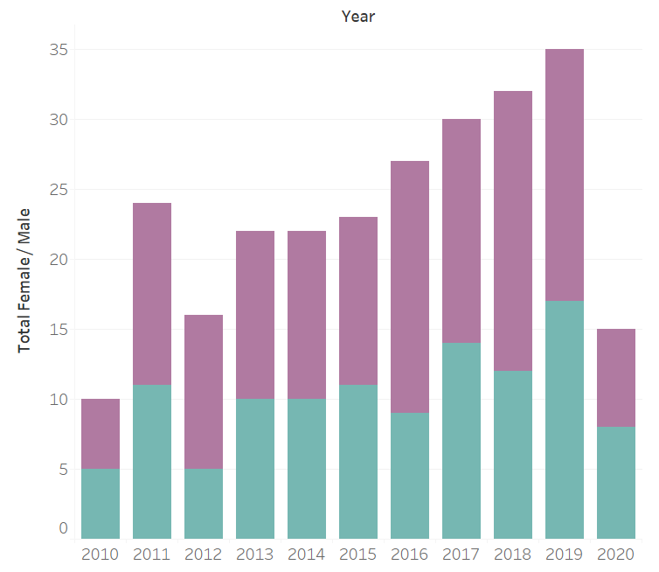
Key Findings | Data – Gender Breakdown
Overall Female / Male Breakdown
56%
44%
Summary of 10 US-based fellowship programs for a total of 256 recipients over the past 10 years

Slide 14
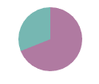
Key Findings | Program Summary
Alvin Ailey
BalletX
Guggenheim
Joffrey
Joyce
44%
31%
61%
40%
43%
60%
39%
57%
56%
69%
Milwaukee Ballet
National Choreographers Institute
New England Foundation of the Arts
NYC Centre
NYU Center for Ballet
20%
63%
17%
29%
43%
37%
80%
83%
57%
71%
All Programs

Slide 15
Recommendations
“There will be people who say to you, ‘You are out of your lane’ … They are burdened by only having the capacity to see what has always been instead of what can be. But don’t let that burden you.”
- Kamala Harris, 2020 Black Girls Lead Conference

Slide 16
Recommendations | Background
“Once an initial category-based assessment has been made, thereafter new information is interpreted in a biased way, favoring consistency with the initial impression, a process known as confirmatory categorization.”
- Iris Bohnet, What Works
A potential negative effect of generic training is moral licensing, which refers to the phenomenon of people rationalizing bad behavior because they’ve previously done something positive for others or themselves.
Research suggests that women can either be seen as likable or credible, but not both. This is a bind.
Recency bias and hindsight bias inhibit objective and equitable decision making.

Slide 17
Recommendations
1
More Data:
solicit further information from ballet companies and public sources to close data gaps
Potential data to gather :
Gender split and size of applicant pools for each fellowship
# and types of works created by female vs male choreographers & trend of % female in independent works vs. most recognized works
Span/length of choreographers career
Take reference at other creative industry with similar gender equity issue
Look at:
Selection criteria
Evaluation methods
2
Conduct additional research to identify and explain the career “funnel” of ballet artists and choreographers
Consider surveys and focus group interview to collect key data points

Slide 18
Recommendations
3
Create gender equity scoring through the entire ballet industry career funnel and establish incentives around those equity scores
Become the golden source of information and rank programs according to a scoring methodology
Build in monetary incentives tied to a program’s equity performance (i.e. grants) to drive desired behavior
4
Consider making behavioral design recommendations to ballet companies
Remove names from choreography proposal submissions
“Seeing is believing” – display pictures of female choreographers when/wherever possible

Slide 19
Appendix

Slide 20
Appendix | Data Matrix
 | 2010-2011 | 2011-2012 | 2012-2013 | 2013-2014 | 2014-2015 | 2015-2016 | 2016-2017 | 2017-2018 | 2018-2019 | 2019-2020 | 2020-2021
Alvin Ailey Dance Foundation New Directions Choreography Lab Fellow | NA | Camille Brown (F), Joanna Kotze (F), Adam Barruch (M), Malcolm Low (M) | Jennifer Archibald (F), Joanna Kotze (F), Loni Landon (F), Samantha Speis (F) | Norbert De La Cruz III (M), Nia Love (F), Sonia Dawkins (F), Manuel Vignoulle (M) | Nicholas Villeneuve (M), Natalie Lomonte (F), Stefanie Batten Bland (F), Jacinta Vlad (F) | Ephrat Asherie (F), Brice Mousset (M), Netta Yerushalmy (F), and Juel D. Lane (M) | Jonathan Lee (M), Esme Boyce (F), Laurie Taylor (F), and Sekou McMiller (M) | Chuck Wilt (M) Cameron McKinney (M), Amy Hall Garner (F), and Stuart Singer (M) | Kyle Marshal (M), Davalois Fearon (M), Yusha Sorzano (F), Bryn Cohn (F) | Ross Daniel (M), Helen Simoneau (F), Rebecca Margolick (F), Quilan Arnold (M) | NA
BalletX - Choreographic Mentorship | NA | NA | NA | NA | NA | Yin Yue (F) | Tommie-Waheed Evans (M) | Andrew McNicol (M) | Katarzyna Skarpetowska (F) | Nicole Caruana (F) | NA
Guggenheim Fellowship in Choreography | Jane Comfort (F), Miguel Gutierrez (M), Rennie Harris (F), Morgan Thorson (F), David Zambrano (M), Pavel Zuštiak (M) | Adriana Barenstein (F), Pat Catterson (F), Ananya Chatterjea (F), DD Dorvillier (F), Maria Hassabi (F), Pam Tanowitz (F) | Doug Elkins (M), Trajal Harrell (F), Jodi Melnick (F), Haruko Nishimura (F), Netta Yerushalmy (F) | Luciana Achugar (F), Brian Brooks (M), Faye Driscoll (F), David Parker (M), Claire Porter (F) | Ivy Baldwin (F), Andrea Miller (F), Rashaun Mitchell (F), Dean Moss (M), Kate Weare (F) | Raphael Xavier (M), Beth Gill (F), Jennifer Lacey (F), Zoe Scofield (F), Rosy Simas (F) | Camille A. Brown (F), Michelle Ellsworth (F), Emily Johnson (F), Juliana F. May (F), Raphael Xavier (F) | Keely Garfield (F), Keith Hennessy (M), Yvonne Meier (F), Will Rawls (M), Melinda Ring (F), Pramila Vasudevan (F) | John Heginbotham (M), Aparna Ramaswamy (F), Nora Chipaumire (F), Heather Kravas (F), Ranee Ramaswamy (F), Jen Rosenblit (F), Kota Yamazaki (M) | Kimberly Bartosik (F), Colin Gee (M), Jo Kreiter (F), Pontus Lidberg (M), Christopher Rudd (M) | Alex Ketley (M), Gabrielle Lamb (M), Shamel Pitts (M)
Joffrey Ballet - Winning Works | NA | Bennyroyce Royon (M), Carlos dos Santoa, Jr. (M), Ray Mercer (M), Francisco Avina (M), Amy E. Hall (F) | NA | Ma Cong (M), William B. McClellan Jr. (M), Jeremy McQueen (M) | Justin Allen (M), Stefanie Batten Bland (F), Norbert De La Cruz III (M) | Jennifer Archibald (F), Abdul Latif (M), Stephanie Martinez (F) | Jeffery Cirio (M), Christian Denice (M), Mariana Oliveira (F) | Shannon Alvis (F), Sean Aaron Carmon (M), Karen Gabay (F), Jimmy Orrante (F) | Telmo Moreira (M), Omar Roman De Jesus (M), Claudia Schreier (F), Luis Vazquez (M) | Tommie-Waheed Evans (M), Marissa Osato (F), Xiang Xu (M), Edgar Zendejas (M) | Chanel DaSilva (F), Tsai Hsi Hung (F), Pablo Sanchez (M), Durante Verzola (M)
Joyce Org | NA | NA | Pam Tanowitz (F), Liz Gerring (F) | Pam Tanowitz (F), Liz Gerring (F) | NA | NA | NA | Kyle Abraham (M) | NA | NA | Faye Driscoll (F), Caleb Teicher (M)
Milwaukee Ballet - Genesis Competition | NA | Edgar Zendejas (M), Lucas Jervies (M), Mauro de Candia (M) | NA | Gabrielle Lamb (F), James Gregg (M), Lauren Edson (F) | NA | Riccardo de Nigris (M), Matthew Tusa (M), Garrett Smith (M) | NA | Enrico Morelli (M), Mariana Oliveira (F), George Williamson (M) | NA | Mortimer Eipper (M), Aleix Mane (M), Kenneth Tindall (M) | NA
National Choreographers Initiative (NCI) | Anne Marie DeAngelo (F), Helen Heineman (F), Viktor Kabaniaev (M), Peter Quanz (M) | Brian Enos (M), Heather Maloy (F), Peter Pucci (M), Paula Weber (F) | Melissa Barak (F), Thang Dao (M), Darrell Grand Loultrie (M), Wendy Seyb (F) | David Fernandez (M), Susan McCullough (F), Kitty McNamee (F), Petr Zahradnicek (M) | Barry Kerollis (M), Gabrielle Lamb (F), Philip Neal (M), Garrett Smith (M) | Nicolas Blanc (M), Norberto De La Cruz (M), Jimmy Orrante (M), Sarah Tallman (F) | Tom Gold (M), Nicole Haskins (F), Stephanie Martinez (F), Ben Needham-Wood (M) | Suzanne Haag (F), Robert Mills (M), Penny Saunders (F), Christopher Stuart (M) | Kevin Jenkins (M), David Justine (M), Ilya Kozadayev (M?), Mariana Oliveira (F) | Julia Feldman (F), Alan Hineline (M), Alex Ketley (M), Tom Mattingly (M) | Sean Aaron Carmon (M), Mari Meade (F), Katarzyna Skarpetowska (F), Eva Stone (F)
NYU Center for Ballet and Arts (CBA) Residency Fellowship | NA | NA | NA | NA | John Carrafa(M), Ariel Rose(F), Adriana Pierce(F), Christopher d’Amboise(M) | Melissa Barak(F), John Selya(M) | Claudia Schreier(F), Emily Coates(F), Jonah Bokaer(M), Jessica Lang(F), Pam Tanowitz(F), Alexander Whitley(M) | Mariana Oliveira(F), Preeti Vasudevan(F),Annie-B Parson(F), Christopher Williams(M), Danielle Agami(F) | Pontus Lidberg(M), Ashley Bouder(F), Stefanie Batten Bland(F), Lauren Lovette(F), Netta Yerushalmy(F), Gemma Bond(F), Shannon Glover(F), Wubkje Kuindersma(F), | Kimberly Bartosik(F),Alice Sheppard(F),Samar Haddad King(F), Milena Sidorova(F), Emily Kikta(F), Elizabeth (Betsy) Coker(F),Abdul Latif (M), George Williamson(M), Kim Brandstrup(M), Caili Quan9F), Megan Williams(F), | Sarah Foster-Sproull(F), Tommie-Waheed Evans(M),
NYC Centre | na | Emery LeCrone(F), ANDREA MILLER (F) | Pontus Lidberg (M) | Gabrielle Lamb(F) | NA | Jessica Lang(F) | Pam Tanowitz(F), michelle dorrance(F) | Gemma Bond (F), Dance Heginbotham(M) | EPHRAT ASHERIE (F), NETTA YERUSHALMY(F) | HELEN SIMONEAU (F) | NA
New England Foundation for the Arts - Nat'l Dance Project - Production Grant | NA | NA | NA | NA | SIDRA BELL (F), Mark Morris (M) | NA | Alonzo King (M), Annabelle Lopez Ochoa (F) | NA | Alvin Ailey (M), Claudia Schreier (F) | Amalia Viviana Basanta Hernandez (F), Annabelle Lopez Ochoa(F) | NA

Slide 21
Appendix | Fellowship Programs with no data
New York Choreographic Institute (NYCI)
New York Foundation for the Arts - Artists' Fellowship
BANFF Intercultural Indigenous Choreographers Creation Lab
Ballet Hispanico - Instituto Choreografico
MANCEE (Maggie Allesee National Center for Choreography)
NCCAkron (National Choreography Center Akron)
We were not able to find historic data on the fellowship recipients for these programs and had to eliminate these from our analysis

